Slide 1


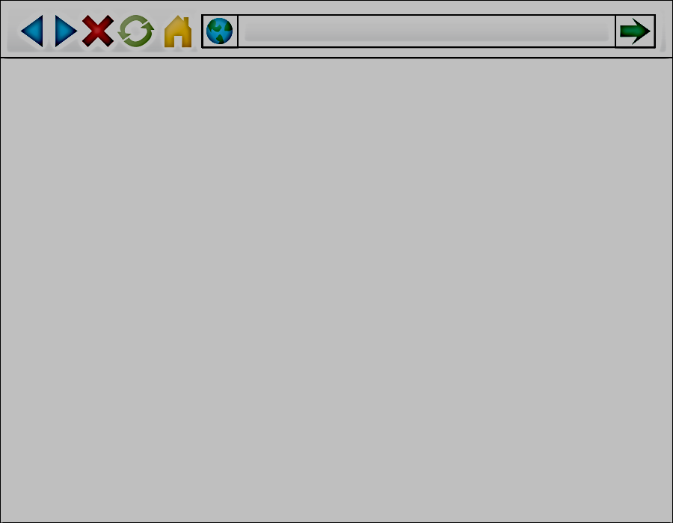

Observer
Executor
- Run observer
- Select a labshelf
Analysis Plugins
Experiment/
Scenario Plugins
PhoneApp
Web
Access
- Create a user and
a lab notebook
- Load an experiment
- Launch/pause/resume
an experiment
- Analyze the results
of the completed
run using plugins
Run an experiment
based on a scenario
- Populate tables
- Change table cardinality
- Execute and time queries defined in the experiment
Monitor
experiments
Monitor
experiments
- Poll any pending experiment
- Update experiment status
- Store experiment results (query execution time, query plan, plan operator estimates, process
information)
Experiment Subject
(DBMS)
LabShelf
DBMS
Same (local)
machine
Store experiment and analysis results

Slide 2
AZDBLab Architecture
Observer
Executor
Analysis Plugins
Experiment/
scenario Plugins
- Run observer
- Select a labshelf
Run an experiment
based on a scenario
- Populate tables
- Change table cardinality
- Execute and time queries defined in the experiment
- Create a user and
a lab notebook
- Load an experiment
- Launch/pause/resume
an experiment run
- Analyze the results
of the completed run using plugins
- Poll any
pending run
- Update
experiment run status
- Store query
execution results
(elapsed time,
query plan and
plan operator estimates)
Experiment Subject
(DBMS)
LabShelf
Server
Store experiment and analysis results

Slide 3
Write a Scenario
Data Population Spec
Table Cardinality Variation Spec
Query Generation Spec
Referenced by
Referenced by
Write an Experiment Spec
Load the Experiment
Run the Experiment
Analyze the Experiment Results

Slide 4
Pending
Running
Completed
Launch an
Experiment Run
Aborted
Paused
Resume

